Slide 1
meta enc確認方法

Slide 2
ext4の形式を読む
参考
Ext4 Disk Layout - Ext4 (kernel.org)
ext4：ディスクレイアウト調査中めも1 - φ(・・*)ゞ ｳｰﾝ カーネルとか弄ったりのメモ (hatenablog.com)

Slide 3
dumpe2fs /dev/dm-0 結果
hexdump –C /dev/dm-0 結果
アドレスと意味に対応・・（中・・）
# dumpe2fs /dev/dm-0
dumpe2fs 1.46.5 (30-Dec-2021)
Filesystem volume name: <none>
Last mounted on: /mnt/meta_enc
Filesystem UUID: 9877b30d-8003-4584-94a0-553bc7b0240a
Filesystem magic number: 0xEF53
Filesystem revision #: 1 (dynamic)
Filesystem features: has_journal ext_attr resize_inode dir_index filetype needs_recovery encrypt sparse_super large_file
Filesystem flags: signed_directory_hash
Default mount options: user_xattr acl
Filesystem state: clean
Errors behavior: Continue
Filesystem OS type: Linux
Inode count: 4096
Block count: 4096
Reserved block count: 204
Overhead clusters: 1284
Free blocks: 2805
Free inodes: 4085
First block: 0
Block size: 4096
Fragment size: 4096
Blocks per group: 32768
Fragments per group: 32768
Inodes per group: 4096
Inode blocks per group: 256
Filesystem created: Wed Aug 23 05:34:51 2023
Last mount time: Wed Aug 23 05:35:20 2023
Last write time: Wed Aug 23 05:35:20 2023
Mount count: 2
Maximum mount count: -1
Last checked: Wed Aug 23 05:34:51 2023
Check interval: 0 (<none>)
Lifetime writes: 40 kB
Reserved blocks uid: 0 (user root)
Reserved blocks gid: 0 (group root)
First inode: 11
Inode size: 256 bytes
Required extra isize: 32
Desired extra isize: 32
Journal inode: 8
Default directory hash: half_md4
Directory Hash Seed: ca9f278e-deaa-4a78-91bf-9b339be05173
Journal backup: inode blocks
Journal features: (none)
Total journal size: 4096k
Total journal blocks: 1024
Max transaction length: 1024
Fast commit length: 0
Journal sequence: 0x00000005
Journal start: 1
Group 0: (Blocks 0-4095)
Primary superblock at 0, Group descriptors at 1-1
Block bitmap at 2 (+2)
Inode bitmap at 3 (+3)
Inode table at 4-259 (+4)
2803 free blocks, 4083 free inodes, 3 directories
Free blocks: 1293-4095
Free inodes: 14-4096
00000000 00 00 00 00 00 00 00 00 00 00 00 00 00 00 00 00 |................|
*
00000400 00 10 00 00 00 10 00 00 cc 00 00 00 f5 0a 00 00 |................|
00000410 f5 0f 00 00 00 00 00 00 02 00 00 00 02 00 00 00 |................|
00000420 00 80 00 00 00 80 00 00 00 10 00 00 98 9a e5 64 |...............d|
00000430 98 9a e5 64 02 00 ff ff 53 ef 01 00 01 00 00 00 |...d....S.......|
00000440 7b 9a e5 64 00 00 00 00 00 00 00 00 01 00 00 00 |{..d............|
00000450 00 00 00 00 0b 00 00 00 00 01 00 00 3c 00 00 00 |............<...|
00000460 06 00 01 00 03 00 00 00 98 77 b3 0d 80 03 45 84 |.........w....E.|
00000470 94 a0 55 3b c7 b0 24 0a 00 00 00 00 00 00 00 00 |..U;..$.........|
00000480 00 00 00 00 00 00 00 00 2f 6d 6e 74 2f 6d 65 74 |......../mnt/met|
00000490 61 5f 65 6e 63 00 00 00 00 00 00 00 00 00 00 00 |a_enc...........|
000004a0 00 00 00 00 00 00 00 00 00 00 00 00 00 00 00 00 |................|
*
000004e0 08 00 00 00 00 00 00 00 00 00 00 00 ca 9f 27 8e |..............'.|
000004f0 de aa 4a 78 91 bf 9b 33 9b e0 51 73 01 01 00 00 |..Jx...3..Qs....|
00000500 0c 00 00 00 00 00 00 00 7b 9a e5 64 0a 01 00 00 |........{..d....|
00000510 0b 01 00 00 0c 01 00 00 0d 01 00 00 0e 01 00 00 |................|
00000520 0f 01 00 00 10 01 00 00 11 01 00 00 12 01 00 00 |................|
00000530 13 01 00 00 14 01 00 00 15 01 00 00 16 01 00 00 |................|
00000540 00 00 00 00 00 00 00 00 00 00 00 00 00 00 40 00 |..............@.|
00000550 00 00 00 00 00 00 00 00 00 00 00 00 20 00 20 00 |............ . .|
00000560 01 00 00 00 00 00 00 00 00 00 00 00 00 00 00 00 |................|
00000570 00 00 00 00 00 00 00 00 28 00 00 00 00 00 00 00 |........(.......|
00000580 00 00 00 00 00 00 00 00 00 00 00 00 00 00 00 00 |................|
*
00000640 00 00 00 00 00 00 00 00 04 05 00 00 00 00 00 00 |................|
00000650 00 00 00 00 01 04 00 00 00 00 00 00 00 00 00 00 |................|
00000660 00 00 00 00 00 00 00 00 00 00 00 00 00 00 00 00 |................|
*
00001000 02 00 00 00 03 00 00 00 04 00 00 00 f3 0a f3 0f |................|
00001010 03 00 04 00 00 00 00 00 00 00 00 00 00 00 00 00 |................|
00001020 00 00 00 00 00 00 00 00 00 00 00 00 00 00 00 00 |................|
*
00002000 ff ff ff ff ff ff ff ff ff ff ff ff ff ff ff ff |................|
*
000020a0 ff 1f 00 00 00 00 00 00 00 00 00 00 00 00 00 00 |................|
000020b0 00 00 00 00 00 00 00 00 00 00 00 00 00 00 00 00 |................|
*
00002200 ff ff ff ff ff ff ff ff ff ff ff ff ff ff ff ff |................|
*
00003000 ff 1f 00 00 00 00 00 00 00 00 00 00 00 00 00 00 |................|
00003010 00 00 00 00 00 00 00 00 00 00 00 00 00 00 00 00 |................|
*
00003032 ff ff ff ff ff ff ff ff ff ff ff ff ff ff ff ff |................|
*
00004000 00 00 00 00 00 00 00 00 7b 9a e5 64 7b 9a e5 64 |........{..d{..d|
00004010 7b 9a e5 64 00 00 00 00 00 00 00 00 00 00 00 00 |{..d............|
00004020 00 00 00 00 00 00 00 00 00 00 00 00 00 00 00 00 |................|
*
00004100 ed 41 00 00 00 10 00 00 3d 9b e5 64 28 9b e5 64 |.A......=..d(..d|
00004110 28 9b e5 64 00 00 00 00 00 00 04 00 08 00 00 00 |(..d............|
00004120 00 00 00 00 01 00 00 00 04 01 00 00 00 00 00 00 |................|
00004130 00 00 00 00 00 00 00 00 00 00 00 00 00 00 00 00 |................|
*
00004180 20 00 00 00 18 97 a9 a4 18 97 a9 a4 d4 86 9e 3e | ..............>|
00004190 7b 9a e5 64 00 00 00 00 00 00 00 00 00 00 00 00 |{..d............|
000041a0 00 00 00 00 00 00 00 00 00 00 00 00 00 00 00 00 |................|
*
00004600 80 81 00 00 00 c0 40 00 7b 9a e5 64 7b 9a e5 64 |......@.{..d{..d|
00004610 7b 9a e5 64 00 00 00 00 00 00 01 00 08 00 00 00 |{..d............|
00004620 00 00 00 00 00 00 00 00 00 00 00 00 00 00 00 00 |................|
*
00004650 00 00 00 00 00 00 00 00 00 00 00 00 09 01 00 00 |................|
00004660 00 00 00 00 00 00 00 00 00 00 00 00 01 00 00 00 |................|
00004670 00 00 00 00 00 00 00 00 00 00 00 00 00 00 00 00 |................|
00004680 20 00 00 00 00 00 00 00 00 00 00 00 00 00 00 00 | ...............|
00004690 7b 9a e5 64 00 00 00 00 00 00 00 00 00 00 00 00 |{..d............|
00000000 00 00 00 00 00 00 00 00 00 00 00 00 00 00 00 00 |................|
*
00000400 00 10 00 00 00 10 00 00 cc 00 00 00 f5 0a 00 00 |................|
00000410 f5 0f 00 00 00 00 00 00 02 00 00 00 02 00 00 00 |................|
00000420 00 80 00 00 00 80 00 00 00 10 00 00 98 9a e5 64 |...............d|
00000430 98 9a e5 64 02 00 ff ff 53 ef 01 00 01 00 00 00 |...d....S.......|
00000440 7b 9a e5 64 00 00 00 00 00 00 00 00 01 00 00 00 |{..d............|
00000450 00 00 00 00 0b 00 00 00 00 01 00 00 3c 00 00 00 |............<...|
00000460 06 00 01 00 03 00 00 00 98 77 b3 0d 80 03 45 84 |.........w....E.|
00000470 94 a0 55 3b c7 b0 24 0a 00 00 00 00 00 00 00 00 |..U;..$.........|
00000480 00 00 00 00 00 00 00 00 2f 6d 6e 74 2f 6d 65 74 |......../mnt/met|
00000490 61 5f 65 6e 63 00 00 00 00 00 00 00 00 00 00 00 |a_enc...........|
000004a0 00 00 00 00 00 00 00 00 00 00 00 00 00 00 00 00 |................|
*
000004e0 08 00 00 00 00 00 00 00 00 00 00 00 ca 9f 27 8e |..............'.|
000004f0 de aa 4a 78 91 bf 9b 33 9b e0 51 73 01 01 00 00 |..Jx...3..Qs....|
00000500 0c 00 00 00 00 00 00 00 7b 9a e5 64 0a 01 00 00 |........{..d....|
00000510 0b 01 00 00 0c 01 00 00 0d 01 00 00 0e 01 00 00 |................|
00000520 0f 01 00 00 10 01 00 00 11 01 00 00 12 01 00 00 |................|
00000530 13 01 00 00 14 01 00 00 15 01 00 00 16 01 00 00 |................|
00000540 00 00 00 00 00 00 00 00 00 00 00 00 00 00 40 00 |..............@.|
00000550 00 00 00 00 00 00 00 00 00 00 00 00 20 00 20 00 |............ . .|
00000560 01 00 00 00 00 00 00 00 00 00 00 00 00 00 00 00 |................|
00000570 00 00 00 00 00 00 00 00 28 00 00 00 00 00 00 00 |........(.......|
00000580 00 00 00 00 00 00 00 00 00 00 00 00 00 00 00 00 |................|
*
00000640 00 00 00 00 00 00 00 00 04 05 00 00 00 00 00 00 |................|
00000650 00 00 00 00 01 04 00 00 00 00 00 00 00 00 00 00 |................|
00000660 00 00 00 00 00 00 00 00 00 00 00 00 00 00 00 00 |................|
*
00001000 02 00 00 00 03 00 00 00 04 00 00 00 f3 0a f3 0f |................|
00001010 03 00 04 00 00 00 00 00 00 00 00 00 00 00 00 00 |................|
00001020 00 00 00 00 00 00 00 00 00 00 00 00 00 00 00 00 |................|
*
00002000 ff ff ff ff ff ff ff ff ff ff ff ff ff ff ff ff |................|
*
000020a0 ff 1f 00 00 00 00 00 00 00 00 00 00 00 00 00 00 |................|
000020b0 00 00 00 00 00 00 00 00 00 00 00 00 00 00 00 00 |................|
*
00002200 ff ff ff ff ff ff ff ff ff ff ff ff ff ff ff ff |................|
*
00003000 ff 1f 00 00 00 00 00 00 00 00 00 00 00 00 00 00 |................|
00003010 00 00 00 00 00 00 00 00 00 00 00 00 00 00 00 00 |................|
*
00003032 ff ff ff ff ff ff ff ff ff ff ff ff ff ff ff ff |................|
*
00004000 00 00 00 00 00 00 00 00 7b 9a e5 64 7b 9a e5 64 |........{..d{..d|
00004010 7b 9a e5 64 00 00 00 00 00 00 00 00 00 00 00 00 |{..d............|
00004020 00 00 00 00 00 00 00 00 00 00 00 00 00 00 00 00 |................|
*
00004100 ed 41 00 00 00 10 00 00 3d 9b e5 64 28 9b e5 64 |.A......=..d(..d|
00004110 28 9b e5 64 00 00 00 00 00 00 04 00 08 00 00 00 |(..d............|
00004120 00 00 00 00 01 00 00 00 04 01 00 00 00 00 00 00 |................|
00004130 00 00 00 00 00 00 00 00 00 00 00 00 00 00 00 00 |................|
*
00004180 20 00 00 00 18 97 a9 a4 18 97 a9 a4 d4 86 9e 3e | ..............>|
00004190 7b 9a e5 64 00 00 00 00 00 00 00 00 00 00 00 00 |{..d............|
000041a0 00 00 00 00 00 00 00 00 00 00 00 00 00 00 00 00 |................|
*
00004600 80 81 00 00 00 c0 40 00 7b 9a e5 64 7b 9a e5 64 |......@.{..d{..d|
00004610 7b 9a e5 64 00 00 00 00 00 00 01 00 08 00 00 00 |{..d............|
00004620 00 00 00 00 00 00 00 00 00 00 00 00 00 00 00 00 |................|
*
00004650 00 00 00 00 00 00 00 00 00 00 00 00 09 01 00 00 |................|
00004660 00 00 00 00 00 00 00 00 00 00 00 00 01 00 00 00 |................|
00004670 00 00 00 00 00 00 00 00 00 00 00 00 00 00 00 00 |................|
00004680 20 00 00 00 00 00 00 00 00 00 00 00 00 00 00 00 | ...............|
00004690 7b 9a e5 64 00 00 00 00 00 00 00 00 00 00 00 00 |{..d............|
Super Block
Block bitmap
inode bitmap
inode table
inode #1
inode #2
inode #7

Slide 4
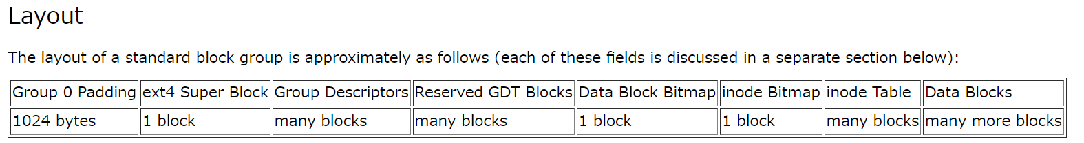
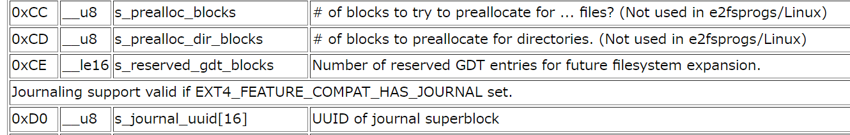
block size
desc数 * desc size/ block size
desc数=TotalBlock/Block per group
4096bytes
4096bytes
inode数 * inode size = 0x 100000 bytes
+ 0x4000 = 0x104000 (block単位で切り上げ)
4096bytes
4096bytes
super blockに情報あり。今回は0byte
0x 100000 bytes
0byte
先頭Addr: 0x0 0x400 0x1000 0x2000 0x2000 0x3000 0x4000 0x104000

Slide 5
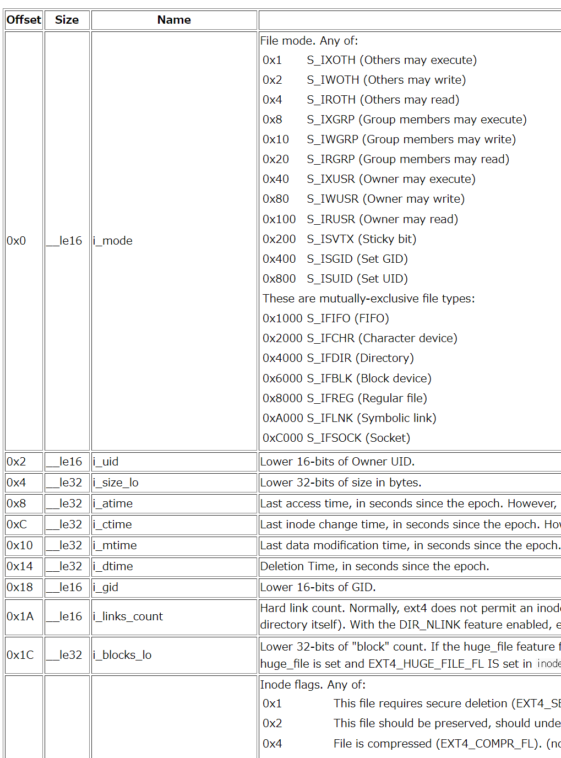
# ls -li
total 20
12 drwxr-xr-x 2 root root 4096 Aug 23 05:38 enc
11 drwx------ 2 root root 16384 Aug 23 05:34 lost+found
# cd enc/
# ls -li
total 4
13 -rw-r--r-- 1 root root 9 Aug 23 05:38 foo.txt
#
inode 0xc
0x00004b00 - 0x00004bff
inode 0xb
inode 0xd
0x00004c00 - 0x00004cff
照らし合せて読む
inode No.
000047a0 00 00 00 00 00 00 00 00 00 00 00 00 00 00 00 00 |................|
*
00004a00 c0 41 00 00 00 40 00 00 7b 9a e5 64 7b 9a e5 64 |.A...@..{..d{..d|
00004a10 7b 9a e5 64 00 00 00 00 00 00 02 00 20 00 00 00 |{..d........ ...|
00004a20 00 00 00 00 00 00 00 00 05 01 00 00 06 01 00 00 |................|
00004a30 07 01 00 00 08 01 00 00 00 00 00 00 00 00 00 00 |................|
00004a40 00 00 00 00 00 00 00 00 00 00 00 00 00 00 00 00 |................|
*
00004a80 20 00 00 00 00 00 00 00 00 00 00 00 00 00 00 00 | ...............|
00004a90 7b 9a e5 64 00 00 00 00 00 00 00 00 00 00 00 00 |{..d............|
00004aa0 00 00 00 00 00 00 00 00 00 00 00 00 00 00 00 00 |................|
*
00004b00 ed 41 00 00 00 10 00 00 79 9b e5 64 5a 9b e5 64 |.A......y..dZ..d|
00004b10 5a 9b e5 64 00 00 00 00 00 00 02 00 08 00 00 00 |Z..d............|
00004b20 00 08 00 00 02 00 00 00 0b 05 00 00 00 00 00 00 |................|
00004b30 00 00 00 00 00 00 00 00 00 00 00 00 00 00 00 00 |................|
*
00004b60 00 00 00 00 02 52 d6 a9 00 00 00 00 00 00 00 00 |.....R..........|
00004b70 00 00 00 00 00 00 00 00 00 00 00 00 00 00 00 00 |................|
00004b80 20 00 00 00 b4 e4 e6 c8 b4 e4 e6 c8 4c c6 eb b3 | ...........L...|
00004b90 28 9b e5 64 18 97 a9 a4 00 00 00 00 00 00 00 00 |(..d............|
00004ba0 00 00 02 ea 01 09 34 00 00 00 00 00 28 00 00 00 |......4.....(...|
00004bb0 00 00 00 00 63 00 00 00 00 00 00 00 00 00 00 00 |....c...........|
00004bc0 00 00 00 00 00 00 00 00 00 00 00 00 00 00 00 00 |................|
00004bd0 00 00 00 00 00 00 00 00 02 01 04 03 00 00 00 00 |................|
00004be0 8e 25 91 0c 12 75 3b e6 50 40 0e 00 2f 2e 78 d7 |.%...u;.P@../.x.|
00004bf0 b6 9f eb a6 5b f3 0c 92 97 3c 89 a2 de 3f b5 f9 |....[....<...?..|
00004c00 a4 81 00 00 09 00 00 00 5a 9b e5 64 5a 9b e5 64 |........Z..dZ..d|
00004c10 5a 9b e5 64 00 00 00 00 00 00 01 00 08 00 00 00 |Z..d............|
00004c20 00 08 00 00 01 00 00 00 0c 05 00 00 00 00 00 00 |................|
00004c30 00 00 00 00 00 00 00 00 00 00 00 00 00 00 00 00 |................|
*
00004c60 00 00 00 00 03 c6 5a 35 00 00 00 00 00 00 00 00 |......Z5........|
00004c70 00 00 00 00 00 00 00 00 00 00 00 00 00 00 00 00 |................|
00004c80 20 00 00 00 b4 e4 e6 c8 b4 e4 e6 c8 b4 e4 e6 c8 | ...............|
00004c90 5a 9b e5 64 b4 e4 e6 c8 00 00 00 00 00 00 00 00 |Z..d............|
00004ca0 00 00 02 ea 01 09 34 00 00 00 00 00 28 00 00 00 |......4.....(...|
00004cb0 00 00 00 00 63 00 00 00 00 00 00 00 00 00 00 00 |....c...........|
00004cc0 00 00 00 00 00 00 00 00 00 00 00 00 00 00 00 00 |................|
00004cd0 00 00 00 00 00 00 00 00 02 01 04 03 00 00 00 00 |................|
00004ce0 8e 25 91 0c 12 75 3b e6 50 40 0e 00 2f 2e 78 d7 |.%...u;.P@../.x.|
00004cf0 74 79 52 33 d7 90 c0 e9 c0 28 3e 49 57 79 3a ed |tyR3.....(>IWy:.|
00004d00 00 00 00 00 00 00 00 00 00 00 00 00 00 00 00 00 |................|
*
000047a0 00 00 00 00 00 00 00 00 00 00 00 00 00 00 00 00 |................|
*
00004a00 c0 41 00 00 00 40 00 00 7b 9a e5 64 7b 9a e5 64 |.A...@..{..d{..d|
00004a10 7b 9a e5 64 00 00 00 00 00 00 02 00 20 00 00 00 |{..d........ ...|
00004a20 00 00 00 00 00 00 00 00 05 01 00 00 06 01 00 00 |................|
00004a30 07 01 00 00 08 01 00 00 00 00 00 00 00 00 00 00 |................|
00004a40 00 00 00 00 00 00 00 00 00 00 00 00 00 00 00 00 |................|
*
00004a80 20 00 00 00 00 00 00 00 00 00 00 00 00 00 00 00 | ...............|
00004a90 7b 9a e5 64 00 00 00 00 00 00 00 00 00 00 00 00 |{..d............|
00004aa0 00 00 00 00 00 00 00 00 00 00 00 00 00 00 00 00 |................|
*
00004b00 ed 41 00 00 00 10 00 00 79 9b e5 64 5a 9b e5 64 |.A......y..dZ..d|
00004b10 5a 9b e5 64 00 00 00 00 00 00 02 00 08 00 00 00 |Z..d............|
00004b20 00 08 00 00 02 00 00 00 0b 05 00 00 00 00 00 00 |................|
00004b30 00 00 00 00 00 00 00 00 00 00 00 00 00 00 00 00 |................|
*
00004b60 00 00 00 00 02 52 d6 a9 00 00 00 00 00 00 00 00 |.....R..........|
00004b70 00 00 00 00 00 00 00 00 00 00 00 00 00 00 00 00 |................|
00004b80 20 00 00 00 b4 e4 e6 c8 b4 e4 e6 c8 4c c6 eb b3 | ...........L...|
00004b90 28 9b e5 64 18 97 a9 a4 00 00 00 00 00 00 00 00 |(..d............|
00004ba0 00 00 02 ea 01 09 34 00 00 00 00 00 28 00 00 00 |......4.....(...|
00004bb0 00 00 00 00 63 00 00 00 00 00 00 00 00 00 00 00 |....c...........|
00004bc0 00 00 00 00 00 00 00 00 00 00 00 00 00 00 00 00 |................|
00004bd0 00 00 00 00 00 00 00 00 02 01 04 03 00 00 00 00 |................|
00004be0 8e 25 91 0c 12 75 3b e6 50 40 0e 00 2f 2e 78 d7 |.%...u;.P@../.x.|
00004bf0 b6 9f eb a6 5b f3 0c 92 97 3c 89 a2 de 3f b5 f9 |....[....<...?..|
00004c00 a4 81 00 00 09 00 00 00 5a 9b e5 64 5a 9b e5 64 |........Z..dZ..d|
00004c10 5a 9b e5 64 00 00 00 00 00 00 01 00 08 00 00 00 |Z..d............|
00004c20 00 08 00 00 01 00 00 00 0c 05 00 00 00 00 00 00 |................|
00004c30 00 00 00 00 00 00 00 00 00 00 00 00 00 00 00 00 |................|
*
00004c60 00 00 00 00 03 c6 5a 35 00 00 00 00 00 00 00 00 |......Z5........|
00004c70 00 00 00 00 00 00 00 00 00 00 00 00 00 00 00 00 |................|
00004c80 20 00 00 00 b4 e4 e6 c8 b4 e4 e6 c8 b4 e4 e6 c8 | ...............|
00004c90 5a 9b e5 64 b4 e4 e6 c8 00 00 00 00 00 00 00 00 |Z..d............|
00004ca0 00 00 02 ea 01 09 34 00 00 00 00 00 28 00 00 00 |......4.....(...|
00004cb0 00 00 00 00 63 00 00 00 00 00 00 00 00 00 00 00 |....c...........|
00004cc0 00 00 00 00 00 00 00 00 00 00 00 00 00 00 00 00 |................|
00004cd0 00 00 00 00 00 00 00 00 02 01 04 03 00 00 00 00 |................|
00004ce0 8e 25 91 0c 12 75 3b e6 50 40 0e 00 2f 2e 78 d7 |.%...u;.P@../.x.|
00004cf0 74 79 52 33 d7 90 c0 e9 c0 28 3e 49 57 79 3a ed |tyR3.....(>IWy:.|
00004d00 00 00 00 00 00 00 00 00 00 00 00 00 00 00 00 00 |................|
*
inode #11
mode: 0x41c0 : d rwx --- ---
uid: 0x0000
size: 0x00004000
atime: 0x
ctime:
dtime
inode #11
inode #12
mode: 0x41ed : d rwx r-x r-x
uid: 0x0000
size: 0x00001000
atime: 0x
ctime:
dtime:
i_block[]:0x0000 050b
inode #12
inode #13
mode: 0x81a4 : file rw- r-x r--
uid: 0x0000
size: 0x00000009: 9 bytes
atime: 0x
ctime:
dtime:
i_block[]:0x0000 050c
inode #13
inodeの中身（DataBlock）は次ページ

Slide 6
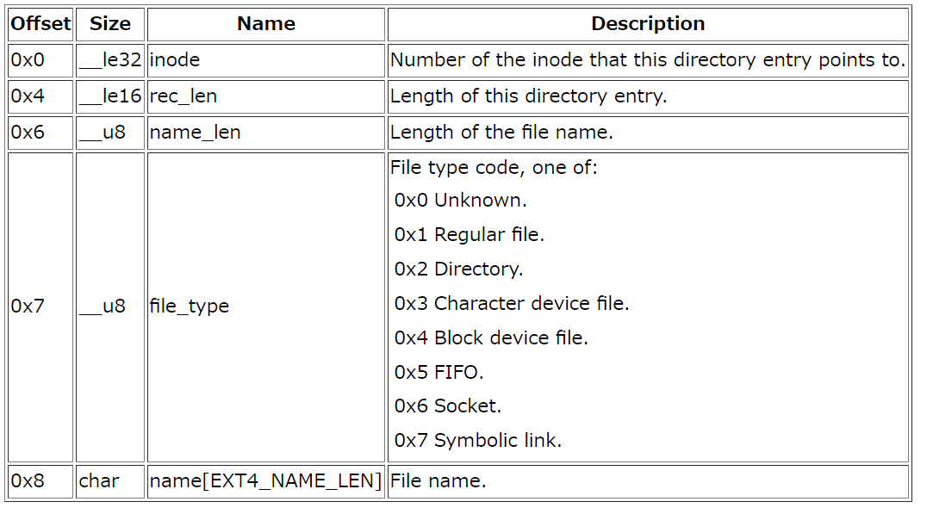
/mnt/meta_data/enc の DataBlock
00122040 00 00 00 00 00 00 00 00 00 00 00 00 00 00 00 00 |................|
*
0050b000 0c 00 00 00 0c 00 01 02 2e 00 00 00 02 00 00 00 |................|
0050b010 0c 00 02 02 2e 2e 00 00 0d 00 00 00 e8 0f 20 01 |.............. .|
0050b020 fe 07 bc 85 ed ea 16 32 b2 57 b1 2f a4 2f ee c0 |.......2.W././..|
0050b030 1c f1 23 13 07 df a5 9f 7e 92 42 8f 70 62 6d ed |..#.....~.B.pbm.|
0050b040 00 00 00 00 00 00 00 00 00 00 00 00 00 00 00 00 |................|
*
0050c000 c1 0e 0d ef 18 73 61 d5 e6 37 26 ce aa e0 67 cf |.....sa..7&...g.|
00122040 00 00 00 00 00 00 00 00 00 00 00 00 00 00 00 00 |................|
*
0050b000 0c 00 00 00 0c 00 01 02 2e 00 00 00 02 00 00 00 |................|
0050b010 0c 00 02 02 2e 2e 00 00 0d 00 00 00 e8 0f 20 01 |.............. .|
0050b020 fe 07 bc 85 ed ea 16 32 b2 57 b1 2f a4 2f ee c0 |.......2.W././..|
0050b030 1c f1 23 13 07 df a5 9f 7e 92 42 8f 70 62 6d ed |..#.....~.B.pbm.|
0050b040 00 00 00 00 00 00 00 00 00 00 00 00 00 00 00 00 |................|
*
0050c000 c1 0e 0d ef 18 73 61 d5 e6 37 26 ce aa e0 67 cf |.....sa..7&...g.|
. dirの情報
.. dirの情報
inode
file name
foo.txtの情報

Slide 7
/mnt/meta_data/enc/foo.txt の DataBlock
0050bfb0 00 7f 41 2b 63 35 e9 c8 3f 07 76 1c 19 8c ba a1 |..A+c5..?.v.....|
0050bfc0 17 32 2e 45 f9 1a 46 48 c1 73 87 56 7b 24 2f 01 |.2.E..FH.s.V{$/.|
0050bfd0 0d cb 70 40 43 b3 57 6a c7 c8 51 d6 7a 83 50 a5 |..p@C.Wj..Q.z.P.|
0050bfe0 8f 78 c8 1b 77 6c 43 ea 88 15 40 bc 7a ec bb da |.x..wlC...@.z...|
0050bff0 87 70 1b 18 64 58 29 79 36 2e 23 11 73 6b 58 aa |.p..dX)y6.#.skX.|
0050c000 6b 70 43 23 dc 2e e9 8b 41 f9 ec 4c 79 a2 db be |kpC#....A..Ly...|
0050c010 e1 c0 db 2b 8d 0b 6f 24 f6 b7 06 65 75 3d 39 51 |...+..o$...eu=9Q|
0050c020 62 be 12 71 77 21 98 c6 e6 18 17 f4 bd 62 21 dc |b..qw!.......b!.|
0050c030 a1 46 67 e7 0b de db 77 09 3b d1 a4 6f aa 93 fd |.Fg....w.;..o...|
0050c040 a9 66 9b 9e 26 b5 e5 b8 ff 71 e7 38 7b 7e a8 80 |.f..&....q.8{~..|
0050c050 79 2d a6 e9 ef ea 8d 8f b2 2e d3 f9 70 d4 a0 1e |y-..........p...|
0050c060 1e cf 78 8d 0a 05 bb 56 24 1e 47 53 0a 1f 43 ac |..x....V$.GS..C.|
0050c070 d6 60 1e 6a 73 d4 16 24 61 4a 47 2c 89 89 4c 98 |.`.js..$aJG,..L.|
0050c080 9b bf 7a 98 b2 64 ff 15 37 a3 73 91 f7 e8 38 2b |..z..d..7.s...8+|
0050c090 8e d3 b0 5e 4e 68 c5 90 ae b9 82 2e 64 65 36 9e |...^Nh......de6.|
0050c0a0 4c 83 1c a2 3a 88 6e 9d c3 2a 2d 27 9a 58 8e f3 |L...:.n..*-'.X..|
0050c0b0 cd 5c 58 e3 bd 60 2d 66 80 ac a4 92 b1 3e d2 af |.\X..`-f.....>..|
0050c0c0 e1 92 50 fc d2 1d 11 da d1 49 59 74 b4 99 97 48 |..P......IYt...H|
0050c0d0 c2 e2 df 49 d5 ff 25 82 19 d1 fa aa 85 d2 66 3c |...I..%.......f<|
0050c0e0 f8 76 36 2e fb 2d 09 d8 6d b8 c5 4a bc 3c a3 e6 |.v6..-..m..J.<..|
0050c0f0 91 28 56 83 6b 5d 8c a8 67 dd 25 a4 ff f7 d2 f0 |.(V.k]..g.%.....|
0050c100 06 67 da 6b 12 cc 8c a6 c7 ad 9e 82 90 eb 0a dd |.g.k............|
0050c110 4d 58 48 a3 67 90 85 92 c4 f2 1a ae 61 41 d9 f2 |MXH.g.......aA..|
0050b040 00 00 00 00 00 00 00 00 00 00 00 00 00 00 00 00 |................|
*
0050c000 c1 0e 0d ef 18 73 61 d5 e6 37 26 ce aa e0 67 cf |.....sa..7&...g.|
0050c010 f4 60 22 e0 46 5e a0 60 a2 27 2b 57 50 cc ca e6 |.`".F^.`.'+WP...|
0050c020 a5 6e 53 8c 83 a3 d9 96 fd 46 eb f2 4f 5f 5e c2 |.nS......F..O_^.|
0050c030 de 9f 6c 2b a4 dc 4a a8 cd bd cd 6a 64 d1 de 75 |..l+..J....jd..u|
0050c040 f5 86 c9 61 03 11 a6 0c e0 1a a4 e9 33 a2 3e 60 |...a........3.>`|
0050c050 e6 dd 84 58 f1 8f 18 dc d2 81 05 ee 3b 27 ac 0e |...X........;'..|
0050c060 3e 43 4d e5 39 5d 90 c4 df b0 4f b0 ee 40 af 57 |>CM.9]....O..@.W|
0050c070 c4 d9 07 e2 1f ee 44 d5 05 2a 2f fd 34 54 1c ea |......D..*/.4T..|
0050c080 8b 5a 86 67 63 e9 15 ff e3 be 11 88 8e 4e 19 04 |.Z.gc........N..|
0050c090 30 43 35 22 0b a5 22 df eb f9 ea d6 f5 32 ee 43 |0C5".."......2.C|
0050c0a0 ff 4f 52 47 27 d2 8b af 83 71 02 1c 1a 0b b8 bc |.ORG'....q......|
0050c0b0 85 ce 85 af 41 b8 94 1a dd ca af 78 68 72 d8 28 |....A......xhr.(|
0050c0c0 9f 83 4c 0d cc a9 7a c1 32 10 87 ef d5 99 a0 71 |..L...z.2......q|
0050c0d0 45 36 c8 61 b3 5e 80 9e 5e b8 9b b8 0e 25 57 6a |E6.a.^..^....%Wj|
0050c0e0 4c ce d5 f7 a4 96 e7 93 0b f6 97 a1 18 45 60 54 |L............E`T|
0050c0f0 25 d1 4f 38 ce 2e f2 99 f0 af b6 30 b6 06 d0 e3 |%.O8.......0....|
0050c100 4d 70 23 a7 53 d6 c5 4f 70 53 f6 40 ee f6 eb e9 |Mp#.S..OpS.@....|
0050c110 81 11 a8 db 2d 9c 5b 33 69 38 b2 b7 35 2a 4f d6 |....-.[3i8..5*O.|
0050c120 5f 02 47 a1 75 61 87 33 4d 1f 44 95 68 9d 55 6f |_.G.ua.3M.D.h.Uo|
0050c130 8f 22 21 0b f7 84 95 b6 16 f7 eb 9a 1b 59 97 c3 |."!..........Y..|
0050c140 a5 7c d3 aa 4f a1 ec 02 83 ec 54 34 e4 fc 48 24 |.|..O.....T4..H$|
0050c150 d0 ae 7f 1d 6a 9e cd 06 29 2e 09 22 a5 98 0a e6 |....j...).."....|
:
0050cf50 0c 1a 7d 58 3b 68 c2 46 25 8a 77 a3 33 f6 8f 63 |..}X;h.F%.w.3..c|
0050cf60 a1 12 8b 74 c4 fa 2a e5 0b 1b 16 1e 15 d9 9e e4 |...t..*.........|
0050cf70 09 54 f7 ac 9b 18 81 e7 25 8b 65 59 f5 11 66 fc |.T......%.eY..f.|
0050cf80 9e 21 69 29 a6 87 4c cf 33 75 18 a0 65 b6 75 47 |.!i)..L.3u..e.uG|
0050cf90 b1 af 99 97 72 cf eb 6d e0 01 35 3f 8a db 60 db |....r..m..5?..`.|
0050cfa0 d1 e4 05 5b a6 9d 4b d6 5e 4f 8a 49 68 08 64 2d |...[..K.^O.Ih.d-|
0050cfb0 84 a5 74 94 a9 7a 4b 1f 04 3b 4a 09 1f f8 4b d2 |..t..zK..;J...K.|
0050cfc0 59 54 38 56 9b 9d 72 70 c5 95 91 39 0d bf ed e7 |YT8V..rp...9....|
0050cfd0 4a a2 96 0b ba 0a 8a ca 24 19 02 a5 e8 0c cc 5c |J.......$......\|
0050cfe0 e0 66 60 c0 c2 ab 42 fb 38 2e ac 22 d2 9d b4 d4 |.f`...B.8.."....|
0050cff0 20 25 92 cd 43 90 71 80 54 38 c5 ea fd 1e 07 91 | %..C.q.T8......|
0050d000 68 65 6c 6c 6f 20 77 6f 72 6c 64 0a 00 00 00 00 |hello world.....|
0050d010 00 00 00 00 00 00 00 00 00 00 00 00 00 00 00 00 |................|
/dev/sdb1のDump
0x50c000は、/dev/dm-0と同じになっていると思ったが、そういうわけでもなさそう。。
・手で復号してみる？
・デバッガで追ってみる？
/mnt/meta_data/hello.txt の DataBlock
↓
平文で格納されている

Slide 9
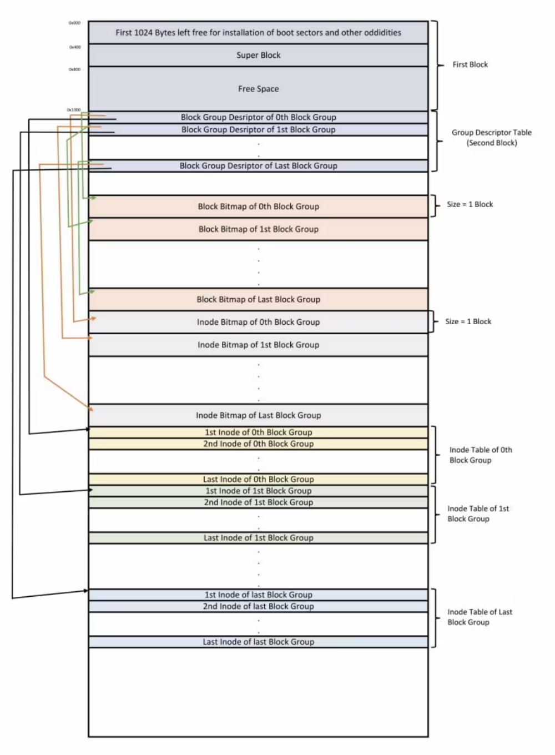

Slide 10
Hexdump –C /dev/dm-0 (encrypt)
00000000 00 00 00 00 00 00 00 00 00 00 00 00 00 00 00 00 |................| //1024B Unused for Boot Sector
*
00000400 00 10 00 00 00 10 00 00 cc 00 00 00 75 0b 00 00 |............y...| //Super Block
Total Inode / Total Block / Free Block
00000400 00 10 00 00 00 10 00 00 cc 00 00 00 75 0b 00 00 |............u...|
00000410 f5 0f 00 00 00 00 00 00 02 00 00 00 02 00 00 00 |................|
00000420 00 80 00 00 00 80 00 00 00 10 00 00 48 b5 a2 5a |............H..Z|
00000430 48 b5 a2 5a 01 00 ff ff 53 ef 01 00 01 00 00 00 |H..Z....S.......|
00000440 e3 86 a2 5a 00 00 00 00 00 00 00 00 01 00 00 00 |...Z............|
00000450 00 00 00 00 0b 00 00 00 80 00 00 00 3c 00 00 00 |............<...|
00000460 c6 02 01 00 6b 04 00 00 b1 01 ac f8 7d 2b 44 a3 |....k.......}+D.|
00000470 ac d0 35 2f 1e 18 70 5b 00 00 00 00 00 00 00 00 |..5/..p[........|
00000480 00 00 00 00 00 00 00 00 2f 6d 6e 74 2f 6d 65 74 |......../mnt/met|
00000490 61 2d 65 6e 63 00 00 00 00 00 00 00 00 00 00 00 |a-enc...........|
000004a0 00 00 00 00 00 00 00 00 00 00 00 00 00 00 00 00 |................|*
*
000004c0 00 00 00 00 00 00 00 00 00 00 00 00 00 00 01 00 |................|
000004d0 00 00 00 00 00 00 00 00 00 00 00 00 00 00 00 00 |................|
000004e0 08 00 00 00 00 00 00 00 00 00 00 00 ad 20 9f 45 |............. .E|
000004f0 a4 77 48 0e 98 26 b9 b0 ab 6b 82 a8 01 01 40 00 |.wH..&...k....@.|
00000500 0c 00 00 00 00 00 00 00 e3 86 a2 5a 0a f3 03 00 |...........Z....|
00000510 04 00 00 00 00 00 00 00 00 00 00 00 0a 00 00 00 |................|
00000520 09 00 00 00 0a 00 00 00 0f 00 00 00 14 00 00 00 |................|
00000530 19 00 00 00 e7 03 00 00 a4 00 00 00 00 00 00 00 |................|
00000540 00 00 00 00 00 00 00 00 00 00 00 00 00 00 40 00 |..............@.|
00000550 00 00 00 00 00 00 00 00 00 00 00 00 00 00 00 00 |................|
00000560 02 00 00 00 00 00 00 00 00 00 00 00 00 00 00 00 |................|
00000570 00 00 00 00 04 01 00 00 11 00 00 00 00 00 00 00 |................|
00000580 00 00 00 00 00 00 00 00 00 00 00 00 00 00 00 00 |................|*
00000650 00 00 00 00 01 04 00 00 00 00 00 00 00 00 00 00 |................|
00000660 00 00 00 00 00 00 00 00 00 00 00 00 00 00 00 00 |................|
*
00001000 03 00 00 00 13 00 00 00 23 00 00 00 6f 0b f2 0f |........#...o...| // Free Block (0x0b6f = )
00001010 03 00 04 00 00 00 00 00 47 9b b9 da f2 0f 37 3f |........G.....7?|
00001020 00 00 00 00 00 00 00 00 00 00 00 00 00 00 00 00 |................|
00001030 00 00 00 00 00 00 00 00 6e 86 57 1f 00 00 00 00 |........n.W.....|
00001040 00 00 00 00 00 00 00 00 00 00 00 00 00 00 00 00 |................|
*
00003000 ff ff ff ff ff ff ff ff ff ff ff ff ff ff ff ff |................| // Group 0 Block Bitmap
*
00003090 ff ff 01 00 00 00 00 00 00 00 00 00 00 00 00 00 |................|
000030a0 00 00 00 00 00 00 00 00 00 00 00 00 00 00 00 00 |................|
*
00003200 ff ff ff ff ff ff ff ff ff ff ff ff ff ff ff ff |................|*
00013000 ff 3f 00 00 00 00 00 00 00 00 00 00 00 00 00 00 |.?..............| // Group 0 Inode Bitmap
00013010 00 00 00 00 00 00 00 00 00 00 00 00 00 00 00 00 |................|
*
00013200 ff ff ff ff ff ff ff ff ff ff ff ff ff ff ff ff |................|
*
00014000 00 00 00 00 00 00 00 00 e3 86 a2 5a e3 86 a2 5a |...........Z...Z|
00014010 e3 86 a2 5a 00 00 00 00 00 00 00 00 00 00 00 00 |...Z............|
00014020 00 00 00 00 00 00 00 00 00 00 00 00 00 00 00 00 |................|
*
00022ff0 00 00 00 00 00 00 00 00 00 00 00 00 a1 9f 4a 2c |..............J,|
00023000 00 00 00 00 00 00 00 00 e3 86 a2 5a e3 86 a2 5a |...........Z...Z| // Group 0 Inode Table (35-162)
00023010 e3 86 a2 5a 00 00 00 00 00 00 00 00 00 00 00 00 |...Z............|
00023020 00 00 00 00 00 00 00 00 00 00 00 00 00 00 00 00 |................|
*
00023070 00 00 00 00 00 00 00 00 00 00 00 00 97 0e 00 00 |................|
00023080 ed 41 00 00 00 10 00 00 d0 b5 a2 5a c1 b5 a2 5a |.A.........Z...Z|
00023090 c1 b5 a2 5a 00 00 00 00 00 00 04 00 08 00 00 00 |...Z............|
000230a0 00 00 08 00 01 00 00 00 0a f3 01 00 04 00 00 00 |................|
000230b0 00 00 00 00 00 00 00 00 01 00 00 00 04 00 00 00 |................|
000230c0 00 00 00 00 00 00 00 00 00 00 00 00 00 00 00 00 |................|
*
000a3000 00 00 00 00 02 00 00 00 00 00 00 00 00 00 00 00 |................| // Group 0 Data Block
000a3010 00 00 00 00 00 00 00 00 00 00 00 00 00 00 00 00 |................|
*
000a4000 ff 1f 00 00 00 00 00 00 00 00 00 00 00 00 00 00 |................|
000a4010 00 00 00 00 00 00 00 00 00 00 00 00 00 00 00 00 |................|
*
000a4200 ff ff ff ff ff ff ff ff ff ff ff ff ff ff ff ff |................|
*
000a5000 03 00 00 00 13 00 00 00 23 00 00 00 72 0b f3 0f |........#...r...|
000a5010 03 00 04 00 00 00 00 00 e3 dc 20 c6 f3 0f 67 f4 |.......... ...g.|
000a5020 00 00 00 00 00 00 00 00 00 00 00 00 00 00 00 00 |................|
000a5030 00 00 00 00 00 00 00 00 4c 70 60 b7 00 00 00 00 |........Lp`.....|
000a5040 00 00 00 00 00 00 00 00 00 00 00 00 00 00 00 00 |................|
*
000a6000 00 00 00 00 00 00 00 00 e3 86 a2 5a e3 86 a2 5a |...........Z...Z|
*
0048b000 0c 00 00 00 0c 00 01 02 2e 00 00 00 02 00 00 00 |................| // Free Block Start (163 -4095)
0048b010 0c 00 02 02 2e 2e 00 00 0d 00 00 00 28 00 20 01 |............(. .|
0048b020 82 1c bc 3a f3 bd 7c 03 95 0c 3b 26 92 e3 3b 28 |...:..|...;&..;(|
0048b030 ed db ca 64 41 be cc af 5b 98 ba 33 79 f8 12 d6 |...dA...[..3y...|

Slide 11
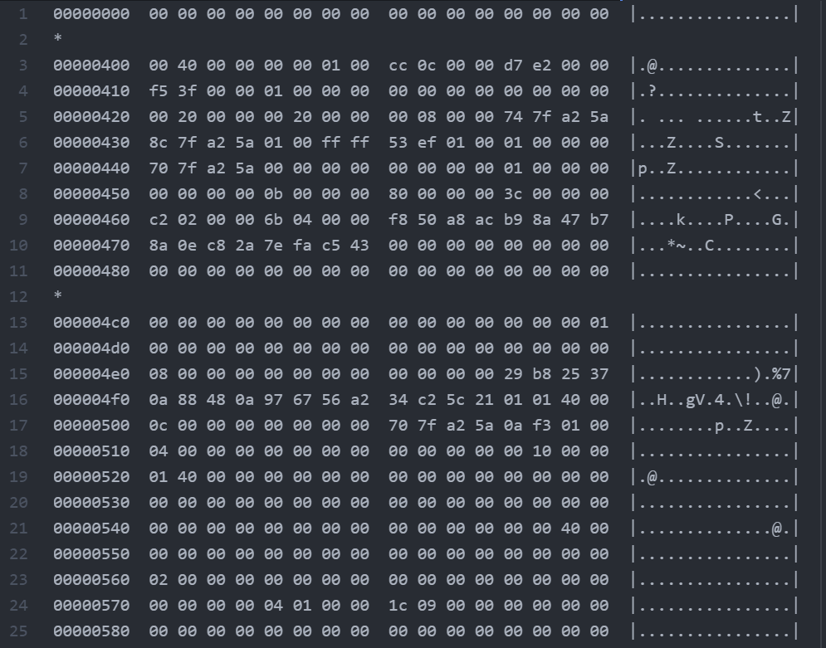
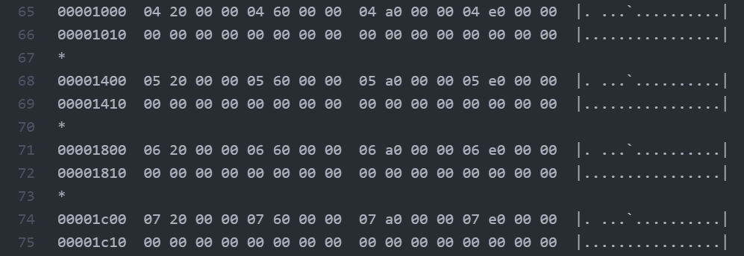
Before make dm-0 layer

Slide 12
